Slide 1
Jacob Summer Update V
Optimization

Slide 2
Last Presentation

Slide 3
Last Week

Slide 4
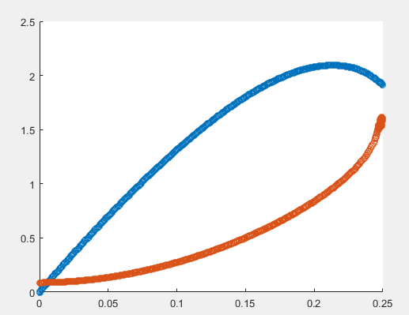
Force Plate
Weighed robot .0713557594 kg – much heavier (vs. .0265kg 3x)
Compare predicted jump heights: 1.17m vs 0.572m
Velocity (blue) mostly linear, approx. max force is 1.03N

Slide 5
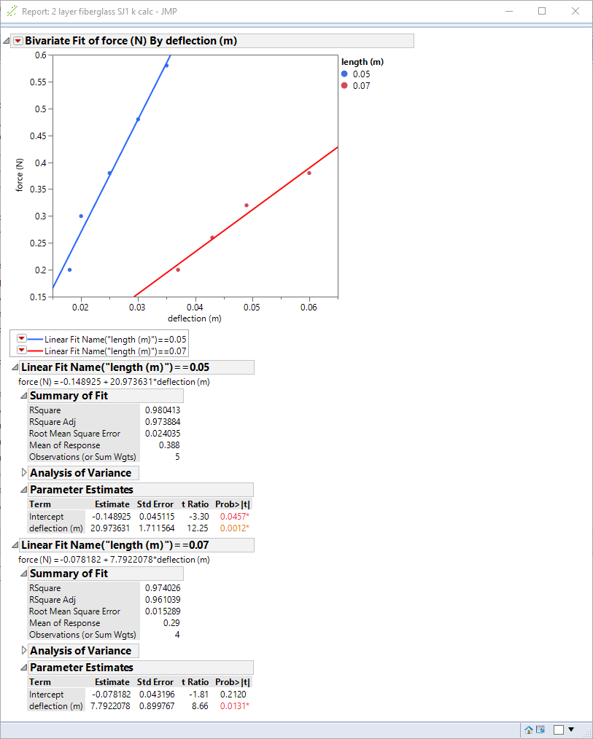
Add deflection to model
Simulate nonrigidity—spring joint in leg members
Cube relationship: k1*L1³=.0026≈.0027=k2*L2³
δ_{B} = F L³ / (3 E I)

Slide 6
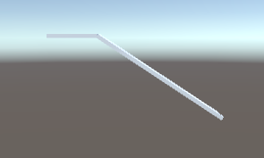
Add Deflection to Unity
Under-predicts deflection for given force per data, but matches formula pretty close, add jmp data and graph(s)
**Video of full thing w/ deflection

Slide 7
Back to force plate
Low res, noisy, high range – amp with moment arm

